Slide 1
Final Engagement
Attack, Defense & Analysis of a Vulnerable Network

Slide 2
Table of Contents
This document contains the following resources:
Network Topology & Critical Vulnerabilities
Exploits Used
Alerts and Avoiding Detect

Slide 3

Network Topology
& Critical Vulnerabilities
3

Slide 4
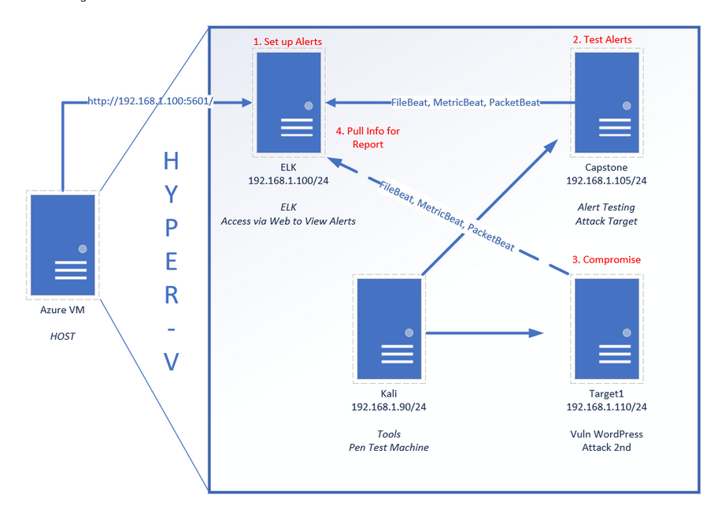
Network Topology
Network
Address Range: 192.168.1.0/24
Netmask: 255.255.255.0
Gateway: 10.0.0.1
Machines
IPv4: 192.168.1.100
OS: Linux
Hostname: Elk
IPv4: 192.168.1.90
OS: Linux
Hostname: Kali
IPv4: 192.168.1.110
OS: Linux
Hostname: Target 1
IPv4: 192.168.1.115
OS: Linux
Hostname: Target 2

Slide 5
Critical Vulnerabilities: Target 1
Our assessment uncovered the following critical vulnerabilities in Target 1.
Vulnerability | Description | Impact
Confidential WordPress Data Exposed | A scan lists items such as usernames | Shows the login in information of users.
Weak Passwords | Less entropy passwords can give unauthorized access. | Lateral Movement
CVE-2006-0151 | Sudo command is not cleared | Privilege Escalation
Notes:
User name of Michael and Stephen

Slide 6
Critical Vulnerabilities: Target 2
Our assessment uncovered the following critical vulnerabilities in Target 2.
Vulnerability | Description | Impact
List of Directories | Unsecured web servers | Directory emulation by brute force
Traversal Path | Servers don’t have authorization to confidential information | Exposed directories and files
CVE-2016-10033 | Allows Remote Code Execution | Reversal Shell

Slide 7
Exploits Used
7

Slide 8
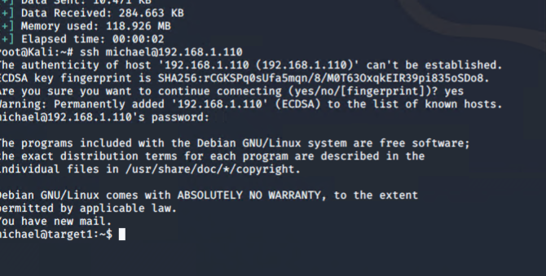
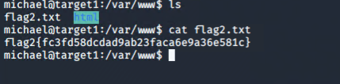
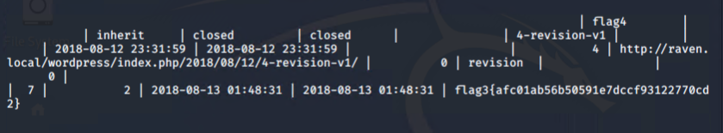
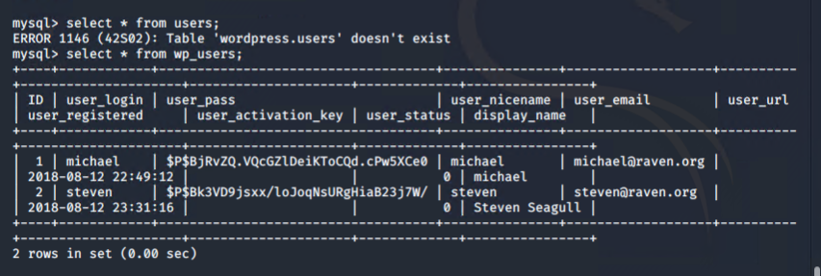
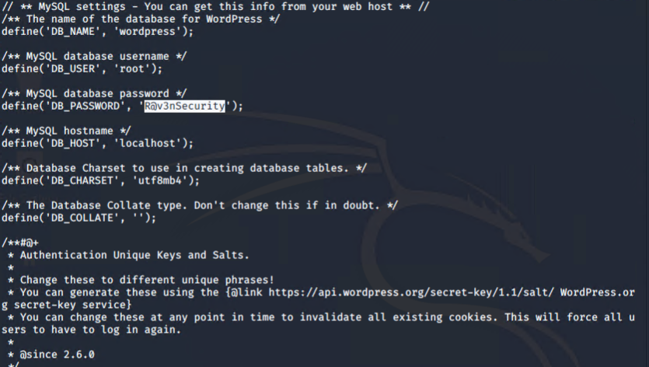
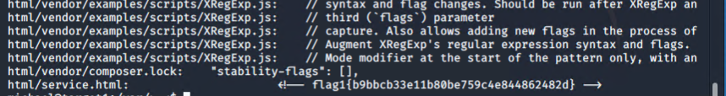
Exploitation: Target 1
Exploits Used:
Wpscan Nmap MySQL
Escalation

Slide 9
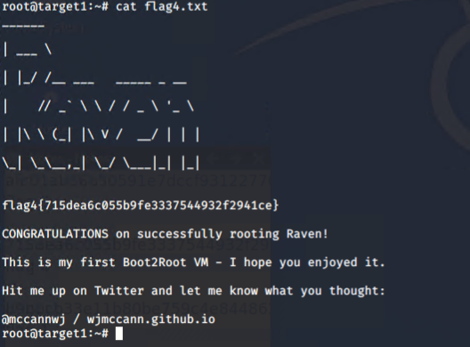
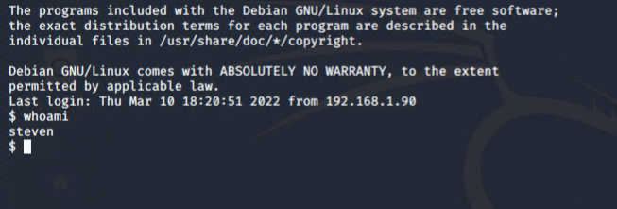
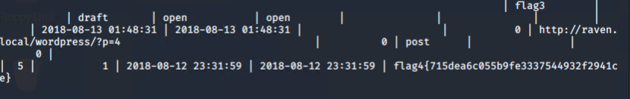
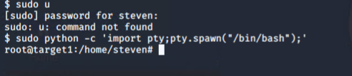
Exploitation: Target 2 (STEVEN)

Slide 10
Avoiding Detection
10

Slide 11
Stealth Exploitation of Excessive HTTP Errors
Monitoring Overview
Alerts Used: Packetbeats*
Metric Used: Top 10 http.response.status_code
Thresholds: Above 400 over 5 minutes

Slide 12
Stealth Exploitation of Http Request Size Monitor
Monitoring Overview
Alerts Used: Packetbeats
Metric Used: Sum of http.requests.bytes over all documents
Thresholds: Above 3500 over 1 minutes

Slide 13
Stealth Exploitation of CPU Usage Monitor
Monitoring Overview
Alerts Used: Packetbeats
Metric Used: Sum of http_request _bytes over all documents
Thresholds: Above 0.5 for the last 1 minute.

Slide 14
Mitigation Detection
Employ high entropy, complex and lengthy
Configure firewall to alert and prevent data gathering.
Implement a multi-factor authentication
Block /?author=<number>
Closed all unused ports.
Use port detectors such as NIDS and HIDS
Set strict privileges to disable path to root escalations
Utilize port 443 for encrypted and secure traffic
Staying update with latest software

